Slide 1
The Age of Revolutions

Slide 2
What is Change?
In your opinion – how can you define change?
Write your definition
Share it with a partner – are there similarities?
Are there things that you would like to see change?
Try to come up with a couple different things.
Share with a different partner
Now… think on a global scale… what things in the world do you think people want to see changed?

Slide 3
GOING AFTER
CHANGE IS REVOLUTION!

Slide 4
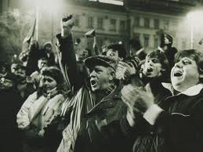
What is Revolution?
Come up with reasons as to why a people might revolt
The are several reasons for why revolutions occur
Political
Social
Religious
Cultural (arts and science, thought and philosophy, technology)
Revolutions completely change or modify an existing system or constitution

Slide 5
What makes a situation ripe for revolution?
New ideas and New thinkers
Anger and discontent with the present establishment
Present needs of the people and population not being met
Violation of human rights
Nationalism:
the doctrine that your national culture and interests are superior to any other
the aspiration for national independence felt by people under foreign domination
the doctrine that nations should act independently (rather than collectively) to attain their goals
Imperialism:
a policy of extending your rule over foreign countries
a political orientation that advocates imperial interests
any instance of aggressive extension of authority
Colonialism:
exploitation by a stronger country of weaker one; the use of the weaker country's resources to strengthen and enrich the stronger country

Slide 6
Who makes a revolution go forward?
New thinkers
Risk Takers
Who are some risk takers you can think of?
http://matadornetwork.com/bnt/10-revolutionary-acts-of-courage-by-ordinary-people/

Slide 7
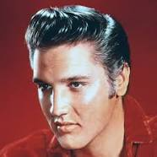
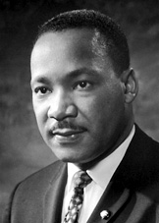
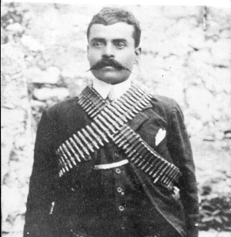
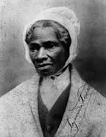
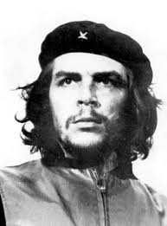
Revolutionaries and Risk Takers
Musical - Elvis Presley, The Beatles
Political – Che Guevara, Vladamir Lenin, Zapata, Ho Chi Min, Michael Collins
Social – Karl Marx, Sojourner Truth
Cultural – General Mao
Human Rights – Dr. King, Nelson Mandela, Gandhi, Cyrus the Great, Abraham Lincoln, Harriet Tubman, Eleanor Roosevelt
Military – Hannibal, Oliver Cromwell

Slide 8
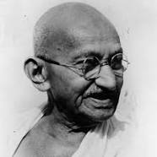
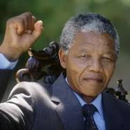
Risk Takers Assignment
Please refer to handout
Group of 3 or 4
Pick a risk taker of your choice
Research your risk taker
All members should take notes:
Brief synopsis of their life that lead to them being a risk taker
Explain WHY they are considered to be a Risk Taker
Explain HOW they contributed to change
Explain the RESULTS of their Efforts
Create an animoto that highlights this Risk Taker
You must include your sources

Slide 9
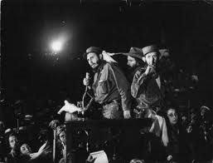
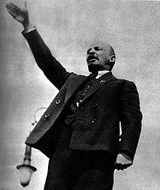
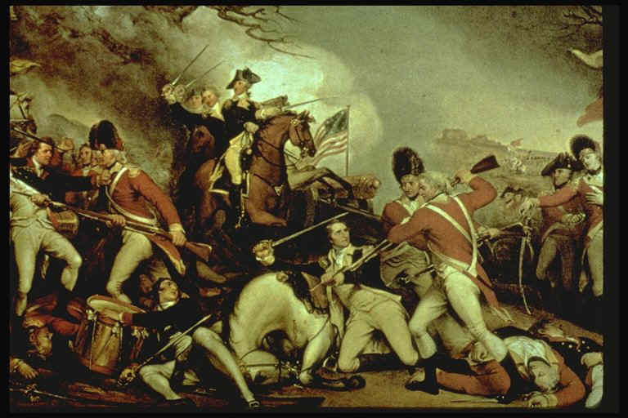
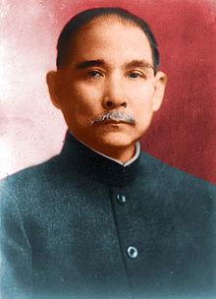
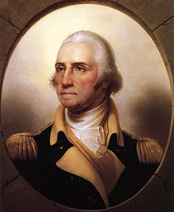
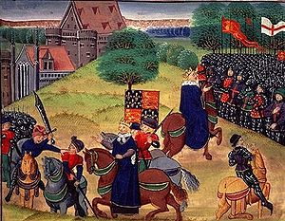
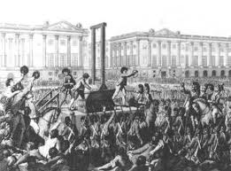
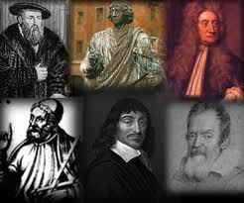
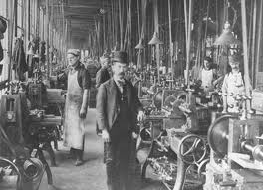
What are some of the revolutions that you can think of?

Slide 10
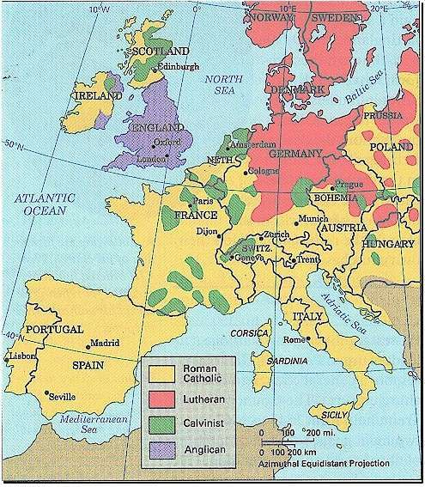
What situations in Europe lead up to the various revolutions?
1. Abuse of Power by the Catholic Church
Church was not living up to the lessons it was preaching
Selling Indulgences
Nepotism
Scandals
Schisms
Rise of thinkers and challengers
Luther
Wycliffe
Calvin
Zwingli
Henry VII

Slide 11
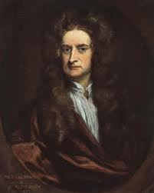
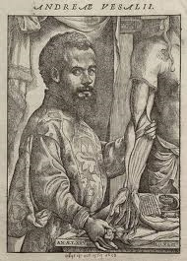
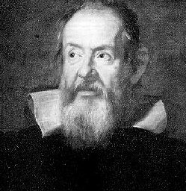
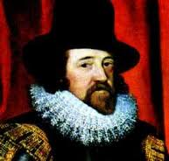
What situations in Europe lead up to the various revolutions?
2. New view of the world
Scientific advances in the 16th and 17th century
Solar centered view of the world (Copernicus & Galileo)
Scientific method (Francis Bacon)
Gravity (Isaac Newton)
The human body (Andreas Vesalius)
The telescope, microscope, time-keeping devices, farming advances, household devices, steam machines – all help lead to industrial revolutions.

Slide 12
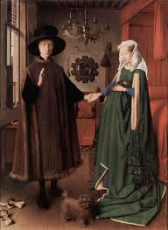
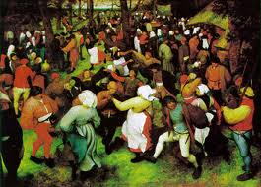
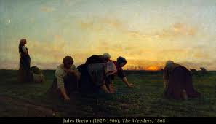
What situations in Europe lead up to the various revolutions?
3. New View of Humanity
People less interested in Religion and more interested in the world around them
Belief that people were capable of doing anything they set their mind to.
Humanism; a system or mode of thought in which human interests predominate.
Seen in art – Greek and Roman themes; concentration on ordinary people and their lives; writing on life, love, and history; questions on the meaning of life and philosophy.
Printing press – books and ideas are spread further and faster. Printing of illustrations as well (helpful for the illiterate)

Slide 13
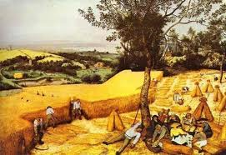
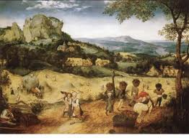
What situations in Europe lead up to the various revolutions?
4. Prosperity
Economic growth
Due to improvements in agricultural production.
Fewer farmers needed to feed the population
Consolidation of strips of fields, improvement in soil, large singular crop production, draining marshes, and high yielding crops brought over from the Americas.
Agriculture still the backbone
Industries needed raw materials for production
Hides – shoes / wool – cloth / grapes & hops – wine & beer
Workers no longer tied to the land as serfs
They owned their land or were tenant farmers
Many moved to towns to find work changing the population landscape from a rural one to an urban one
Industrialization begins

Slide 14
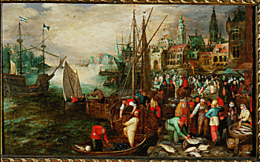
What situations in Europe lead up to the various revolutions?
Prosperity cont.
Trade and overseas exploration
Empires established
Trade encourages growth of the middle class
Landowners and prosperous merchants; opportunities to expand
Middle class growth disrupts old social structure

Slide 15
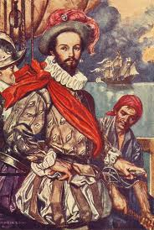
Importance of Trade
“Whoever commands the sea commands the trade; whosoever commands the trade of the world commands the riches of the world, and consequently the world itself”
Sir Walter Raleigh
An important man in Queen Elizabeth’s court, Raleigh was licensed to travel the seas and seize the ships of other nations as well as their cargoes. Pretty much, he was a legal pirate.
What did he mean by his quote?

Slide 16
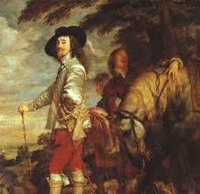
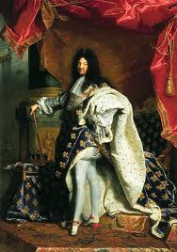
What was the situation in Europe that would lead to its various revolutions?
5. Kings gained too much power
Claimed divine right
Kingly virtues (law making and maintaining peace) became seen as “God given”
Reformation allowed for multiple religions throughout the continent.
Religious tensions stressed and increased political
Kings tried to keep religious power and authority by appointing people who would listen and obey them.
They also undermined nobles by appointing middle class citizens to positions of power, hoping that they’d have puppets to do their bidding.

Slide 17
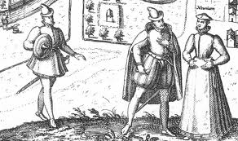
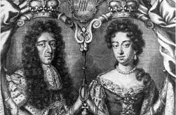
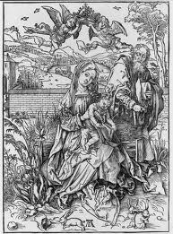
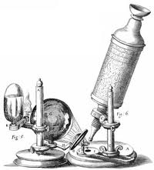
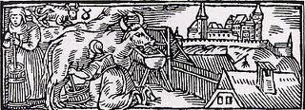
Why would these factors in Europe lead to revolution?
Kings with divine authority
Growth of middle classes
Agricultural growth
New view of humanity
Scientific discoveries
Technological advances

Slide 18
What is your revolution?
Revolutions have charismatic leaders who want to change the established norm.
They are passionate about their cause and have firm ideas of what needs to be changed, and how to change it.
Think about various leaders of revolutions; how do they speak? How do they deliver their messages? What did they need to be to successful?
You are a revolutionary, what is your cause? What changes do you want to have happen?
Prepare a 2 to 3 minute speech to ignite the audience to help champion your cause.
You will be marked on the strength of your argument and the strength of your delivery.

