Slide 1
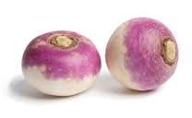
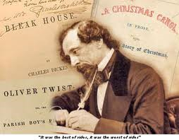
What links can you think of between the photos?

Slide 2
The Industrial Revolution
Learning intention: background and introduction to the mood and people and inventions

Slide 3
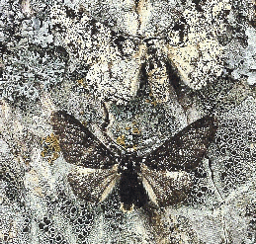
The Peppered Moth
I’d like to introduce you to my little friend…
A testament to the industrial revolution.

Slide 4
This article is about the peppered moth's significance in evolutionary biology. For its evolutionary ancestry, see Insect evolution.
Biston betularia f. typica, the white-bodied peppered moth.
Biston betularia f. carbonaria, the black-bodied peppered moth.
The evolution of the peppered moth over the last two hundred years has been studied in detail. Originally, the vast majority of peppered moths had light colouration, which effectively camouflaged them against the light-coloured trees and lichens which they rested upon. However, because of widespread pollution during the Industrial Revolution in England, many of the lichens died out, and the trees that peppered moths rested on became blackened by soot, causing most of the light-coloured moths, or typica, to die off from predation. At the same time, the dark-coloured, or melanic, moths, carbonaria, flourished because of their ability to hide on the darkened trees.^{[1]}
Since then, with improved environmental standards, light-coloured peppered moths have again become common, but the dramatic change in the peppered moth's population has remained a subject of much interest and study, and has led to the coining of the term industrial melanism to refer to the genetic darkening of species in response to pollutants. As a result of the relatively simple and easy-to-understand circumstances of the adaptation, the peppered moth has become a common example used in explaining or demonstrating natural selection.^{[2]}

Slide 6
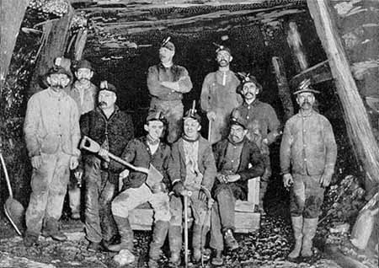

Slide 7
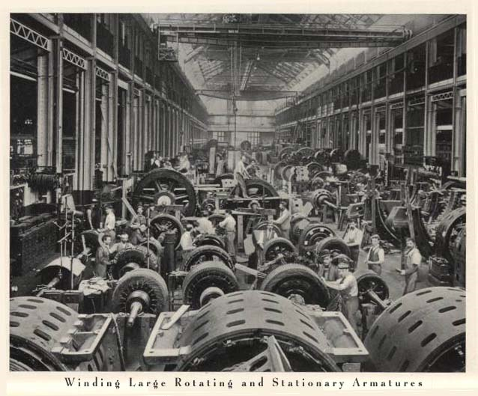

Slide 8
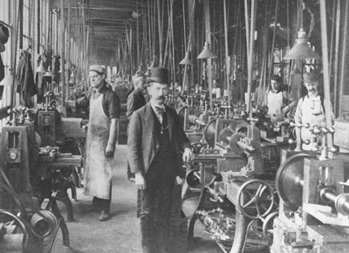

Slide 9
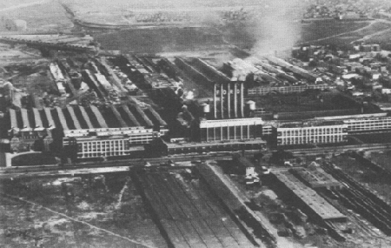
Description of Coketown, Charles Dickens

Slide 10
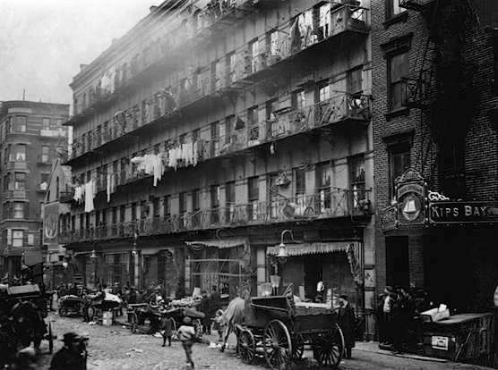
Alexis de Tocqueville in the 1830s:
"From this foul drain, the greatest stream of human industry flows out to fertilize the world. From this filthy sewer pure gold flows. Here humanity attains its most complete development and its most brutish; here civilization works its miracles, and here civilized man is turned back almost into a savage."

Slide 11
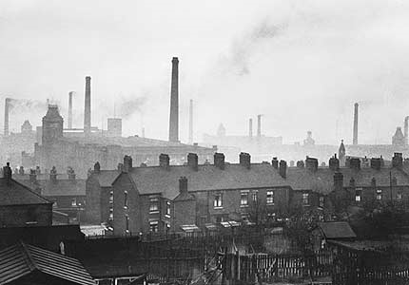
"Manchester streets may be irregular, and its trading inscriptions pretentious, its smoke may be dense, and its mud ultra-muddy, but not any or all of these things can prevent the image of a great city rising before us as the very symbol of civilization, foremost in the march of improvement, a grand incarnation of progress." [Chambers' Edinburgh Journal, 1858; quoted by Briggs, Victorian Cities, 88]

Slide 12
My father was a glass blower. When I was eight years old my father died and our family had to go to the Bristol Workhouse. My brother was sent from Bristol workhouse in the same way as many other children were - cart-loads at a time. My mother did not know where he was for two years. He was taken off in the dead of night without her knowledge, and the parish officers would never tell her where he was

Slide 13
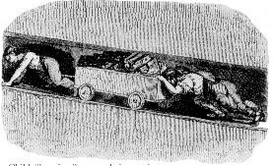
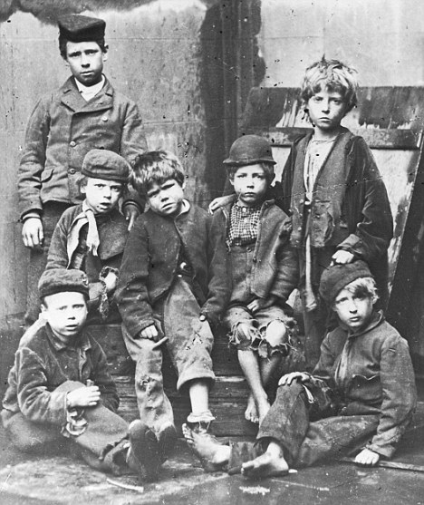
Robert North says, 'I went into the pit at 7 years of age. When I drew by the girdle and chain, the skin was broken and the blood ran down. . . . If we said anything, they would beat us. I have seen many draw at 6. They must do it or be beat. They cannot straighten their backs during the day. I have sometimes pulled till my hips have hurt me so that I have not known what to do with myself.'
In the West Riding, it appears, girls are almost universally employed as trappers and hurriers, in common with boys. The girls are of all ages, from 7 to 21. They commonly work quite naked down to the waist, and are dressed - as far as they are dressed at all - in a loose pair of trousers. These are seldom whole on either sex. In many of the collieries the adult colliers, whom these girls serve, work perfectly naked.

Slide 14
George Courtauld, letter to Mr. Mann (11th December, 1813) I have 8 children coming from Islington on Tuesday next and 8 or 10 more on Thursday. I had my choice from upwards of 50 girls of different ages and accepted all but one that were within the age of 10 and thirteen. They are from a very well-conducted workhouse and I really expect and earnestly hope that by continued care and attention my establishment of apprentices will prove a nursery of respectable young women fitted for any of the humble walks of life

Slide 15
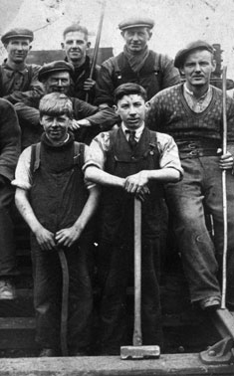
When I entered the mines at eight years or so, at the time workings were not so large for we had not sunk in Scotland to the thicker seams which are now being worked. The condition of the miner's boy then was to be raised about 1 o'clock or 2 o'clock in the morning is the distance was far to travel, and at that time I had to travel a considerable distance, more than three miles' I was raised at that time at 2 o'clock. ... We remained then in the mine until 5 and 6 at night. It was an ironstone mine, very low, working about 18 inches, and in some instances not quite so high... The gases pervading the mines in Scotland at that time were, for the most part, carbonic acid gas... There was no explosive gas in those mines I was in, or scarcely any. I may state incidentally here that in the first ironstone mine I was in there were some 20 or more boys beside myself, and I am not aware at this moment that there is one alive excepting myself.
Alexander MacDonald to the Commission on Trade Unions, 1868

Slide 16
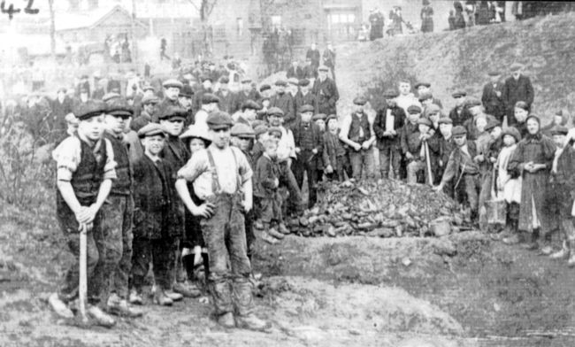

Slide 17
A stable world gone mad
Prior to the Industrial revolution life was simple…
people expected to be born, live, die in the same place. People expected to be what their parents were, stay in the same class each generation, and it would go on.
Now in the Industrial revolution life became complex…
You could move to find work. You were still often stuck in your class; there was small potential to move up. You lived in cramped, dirty cities. Life changed daily.

Slide 18
Isambard Kingdom Brunel
Bridges
Dockyards
Tunnel under the Thames
Great Western Railway
First propeller powered transatlantic steamship
Number 2 on Britain’s top 100 most important people

Slide 19
Samuel Slater: Father of American Industrial Revolution (American Factory System)
Samuel Slater was born in England June 9, 1768,
At age ten he begun work at the cotton mill opened that year by Jedediah Strutt utilising the water frame pioneered by Richard Arkwright.
When his father died and his family indentured Samuel as an apprentice to Strutt.
Slater was well-trained by Strutt, and at age 21 began a systematic study of the latest textile machinery.
Hearing of the American interest in developing similar machines, and aware of British laws against exporting the designs, he memorized as much as he could and departed for New York in 1789
Owned 13 mills in the Rhode Island area.

Slide 20
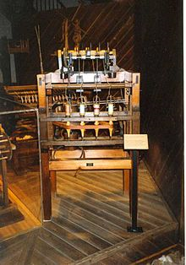
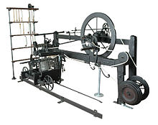
James Hargreaves: The spinning Jenny
Richard Arkwright: The Water Frame
Samuel Crompton: Spinning mule

Slide 21
James Watt: The Steam Engine

Slide 22
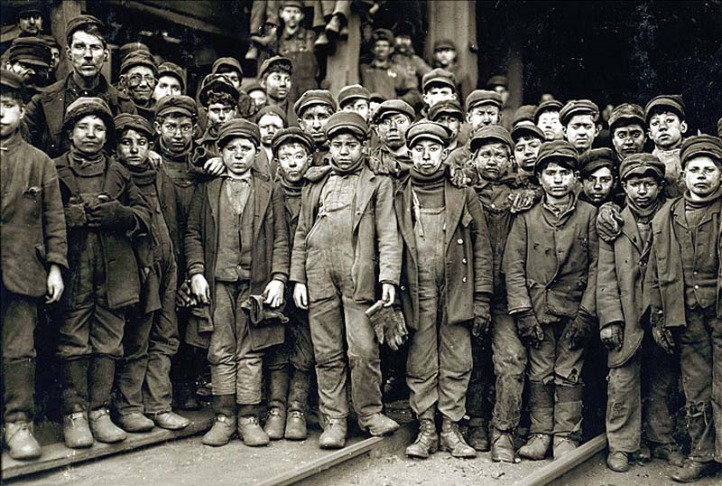
Exit from Class
Using three -five words, summarize your understanding thus far, about the industrial revolution.

