Slide 1
The American Revolution

Slide 2
Background on the Americas
The 13 Colonies of British America were colonies of England
Each colony was independent of the other, with its own governor and its own legislature
Colonists identified themselves with their colony, rather than an American or an Englishman.
The colony was a jewel for England as it provided many raw materials as well as a market to sell finished goods.
The British saw the American colonists as troublesome and argumentative. Americans saw the British as controlling and unreasonable.

Slide 3
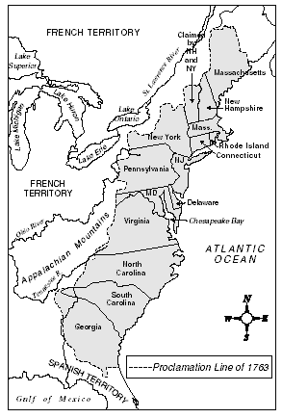
The 13 colonies
Massachusetts
New Hampshire
New York
Rhode island
Connecticut
Pennsylvania
New Jersey
Maryland
Virginia
North Carolina
South Carolina
Georgia
Delaware

Slide 4
What events lead up to the Revolution? The enlightenment
Enlightened thinkers: Locke, Hobbes, Rousseau and others inspire men like Benjamin Franklin, John Adams, and Thomas Jefferson.
Enlightened thinkers argue for the power of human reason and science, freedom from tyrannical government and religious persecution.
Locke states: Government is only legitimate if it protects the rights of the people (life, liberty, and pursuit of prosperity).
If government does not, the people have the right to overthrow it.
Why might these thoughts provoke uprising and the desire for change amongst the American people?

Slide 5
Reading piece: Enlightenment thinkers: a Review
Read through the article.
Pull out (highlight) important arguments and ideas from the various thinkers.
Answer questions 1 – 6
Prior to exiting class answer
Which Enlightenment thinker’s ideas do you find the most “enlightened” in terms of improving the position of the common man? Why do you believe this? 2-3 points.

